Slide 1
Antitrust in Italy
A special focus on the media sector

Slide 2
100 years late ?
Italy’s antitrust law is only 25 years old
It was passed exactly 100 years after the US Sherman Antitrust Act (1890)
Several European countries introduced their Antitrust laws longer before (Germany and the UK in 1948, Spain in 1963, France in 1986)
Only in 2001, more than 10 years later, Antitrust discipline was finally introduced in the Italian Constitution of 1948
1890
US Sherman Antitrust Act
1990 Italy’s Antitrust law
2001
Antitrust discipline ➔ Italian Constitution

Slide 3
The reasons for our delay
Some antitrust norms were already included in the civil code of 1942 (art 2598 on acts involving unfair competition) and in the Constitution of 1948 (art 41 on the right to economic initiative)
No common view about the relationship between the market and the role of the state
State intervention was considered important for the development of national industries and the productive sector
It was a common idea that establishing public monopolies was a necessary tool to tackle private monopolies
Standard antimonopoly law would have weakened the state intervention
Strong presence of the State in the market
made competition hard to develop

Slide 4
State as a manager or as a regulator ?
After decades of direct interventions in the economy, nationalizations, state’s shares and widespread state aid, an antitrust law was finally passed in 1990
All main economic activities and industrial sectors in Italy were publicly owned
Between 1993 and 2000 Italy underwent a € 200 billion (almost 14 trillion rubles) operation of divestment of state owned companies
Local and regional activities still hold indirect interests in about 8000 companies

Slide 5
Last come last served?
Italian antitrust law is a story of success
Italy was the first EU country to pass an antitrust law fully in accordance with the EU regulations in the field
The law not only prevents anti-competitive behaviour, but it renders competition a priority public policy aim in Italy
It compels the Italian legal system to interpret Italian antitrust norms according to EU principles
It establishes an independent Antitrust Authority (Autorità Garante della Concorrenza e del Mercato - AGСM) that enforces the law
The Authority was given the power to voluntarily participate in the legislative process without any request made by the government or other bodies (as it was the case in France with the Conseil de la concurrence)

Slide 6
Last come last served?
A very innovative law for several reasons:
The authority staff was given the same level of the Italian central bank staff
It introduced some best practices, like the public presentation of the annual report before the Parliament
It introduced the concept of public benefit (the benefits brought by regulations restrictive of economic operations must be higher than the benefits brought to the community by competition restrictions)
It has been taken as a model by other legislations

Slide 7
The law in detail
Law No. 287 of October 1990 transposes EU legislation (artt 101-109 of the TFEU and other EU normative acts) into the Italian national law system
It addresses:
restrictive agreements
abuse of dominant position
the creation and/or reinforcement of a dominant position through merger (concentrations)

Slide 8
The law in detail
Interpretation rules
Artt. 101, 102 TFEU
Direct effect / supremacy of EU Law
EU laws enforcement
Principles of EU competition law

Slide 9
The law in detail
1. The law is strictly modeled on articles 101 and 102 TFEU, except for the “effect on trade between Member States”, which defines the boundary between conduct that is subject to EU law and conduct that is governed solely by domestic law
2. The provisions of the law must be interpreted in accordance with the principles of EU competition law
Art. 101, 102 TFEU
Principles of EU competition law

Slide 10
The law in detail
3. Principles of direct effect and supremacy of EU law over national law + Member States’ obligation to “abstain from any measure which could jeopardize the attainment of the objectives of” the EU Treaty = any state measure undermining the effectiveness of EU competition rules may be unenforceable in the national courts
4. In the communications field, the Competition Authority must request the non-binding opinion of the Communications Authority (Autorità per le Garanzie nelle Comunicazioni)
Direct effect / supremacy of EU Law
Non-binding opinion

Slide 11
The Antitrust Authority
The Autorità Garante della Concorrenza e del Mercato (AGCM)
is an Italian quasi-autonomous non-governmental organization
the Authority has the following tasks:
Vigilance against anti-competitive practices (cartels and agreements that may prejudice or restrict fair competition)
Vigilance on takeovers to check concentration ratio and verify market impact
Consumer protection against unfair trade practices and false advertising
Monitoring of conflict-of-interest cases regarding Members of Government and Holders of Public Office
The Authority is partially self-financed and has the Guardia di Finanza (an Italian law-enforcement agency that is part of the armed forces) at its disposal

Slide 12
Sanctions
Unlike in the USA, anti-competition practices have no criminal relevance in the EU and in Italy. The Competition Law does not provide for either criminal sanctions or damage awards
Individuals or companies can bring actions before the civil courts for damages deriving from infringement of the Competition Law
Administrative sanctions can reach 10% of business income
The Italian Authority can impose a fee up to
€ 500,000 for practices against consumers protection

Slide 13
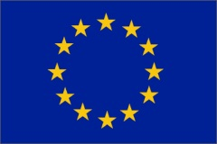
Differences between the EU and the Italian legislation
The EU prohibitions on anti-competition agreements are more restrictive, while the Italian antitrust system tends to weigh the pro-competition and the anti-competition effects of the agreement
Restrictive
Balancing of pro-competition / anti-competition effects

Slide 14
Exemptions for services of general economic interest
At the EU level were qualified as services of general interest, inter alia, telecommunications, energy, transports and postal services
Exemptions are possible only if the conduct in restraint of competition legislation is necessary and a direct consequence of a need to comply with a regulatory precept. The operator must not have any significant degree of autonomy in its choices
The new rules appear as a remedy to the tendency of many public service companies to expand into more and different markets in which a plurality of competing undertakings operate without being able to rely on the same privileges

Slide 15
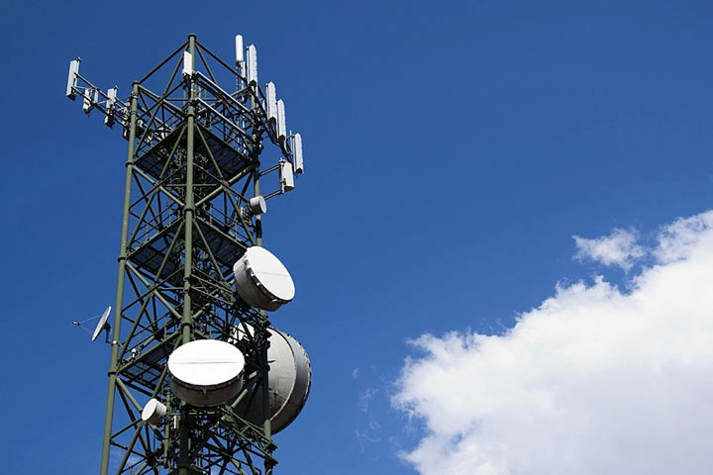
The Italian anomaly
Despite being a good example of antitrust law, Italy is not a good example of antitrust law enforcement in the media sector, due to a mix of politics and economic powers

Slide 16
Authority for Communications Guarantees
The Autorità per le Garanzie nelle Comunicazioni (AGCOM)
is the competition Authority for the communication industries
Creation
July 31, 1997
Legal status
Established by law n. 249 of July 31, 1997
Purpose
Regulator and competition authority for broadcasting, telecommunications and radio-communications sectors. In the field of preventing abuse of dominant position, it only has a consultative role for the Antitrust Authority

Slide 17
Communications sector in Italy
Italian communications sector accounts for more than 3% of Italy’s GDP
(telecommunications stand for 2%, media for 0,9% and postal services for 0,4%).
Italian public TV started in 1954, when RAI — Radiotelevisione italiana S.p.A began a regular television service. RAI is now the national public broadcasting company
Private TV emerged in Italy in the mid-1970s, earlier than in several European countries, but it completely lacked regulation. Italy was the only country with a multichannel radio and television system in which there was no obligation to report facts in an unbiased and fair manner, nor any rules preventing the formation of dominant position
In 2010 the sector started undergoing a recession and the pattern is not likely to change in the short-medium term. This downturn is partly due to the recent crisis and partly to the advent of new technologies and the Internet

Slide 18
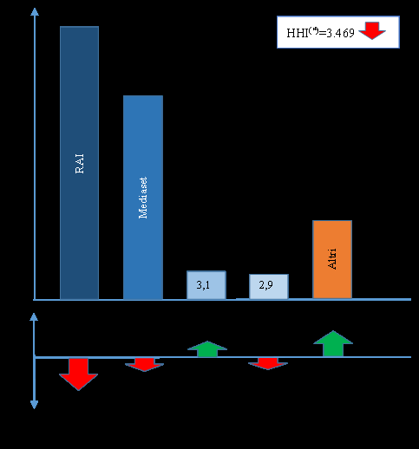
Concentration in the free access tv market
Both free national TV
and paid-for TV
show strong concentration
FREE TV:
RAI (the national public broadcasting company) accounts for more than 47% of the market share
Mediaset (founded by former
Prime Minister Silvio Berlusconi) accounts approximately for 35%
Together, they account for 90% of the revenues
*AGCOM Annual Relation, 2015

Slide 19
Italian Pay - tv market
On the Italian Pay-TV market, only two operators reach almost 100 % of the market share:
21st CenturyFox/Sky Italia with more than 80%
Mediaset Premium with 19%
The index of market concentration is set at more than 6.500 points

Slide 20
Concentrations
There is a concentration when :
two or more companies merge;
two or more undertakings constitute a new joint venture;
there is acquisition of control (which may be sole or joint) of one or more enterprises or parts of them
Concentrations are subject to prior notification, which is compulsory at certain turnover thresholds.
A concentration may constitute or strengthen a dominant position to the extent of eliminating all competitors from the market

Slide 21
How it all began
A 1976 Constitutional Court decision upheld the RAI monopoly at a national level but made privately-owned TV possible within local ambit
About 500 private stations emerged by1980, one of which (Canale 5) belonged to Silvio Berlusconi, who subsequently bought his two main competitors (Rete4 and Italia1)
By 1984 S. Berlusconi’s three channels attracted a combined audience share of 40%, almost like the one of RAI’s three public service channels (duopoly)
The first legislation in the field (Law Mammì of 1990) allowed the status quo. Subsequently, Italy became the only European country where a private actor was allowed to run three national terrestrial channels

Slide 22
Telecracy vs Antitrust in the media sector
1) Failure to regulate commercial television and prevent media
concentration
2) Lack of conflict-of-interest rules in Italy
3) Lack of relevant legislation at EU level
Italy is only a pioneering example
(large media corporations emerged in Europe during the 1990s)

Slide 23
Italian de – facto monopoly in the private sector
In 1994 the Constitutional Court stated that the Mammì law was unconstitutional in the part allowing S. Berlusconi to run three national channels (against art. 21 of the Italian Constitution)
A new law required S. Berlusconi to give up one of his three channels, but by the time he came back to power (2001), the norm had not been enforced
In 2000 a ‘’par condicio’’ law was issued. It banned paid electoral advertisement, in order to prevent the use of media power to influence the public in future elections

Slide 24
Competition in the media sector at the EU level
Is the Commission in favour of 'regulated' de facto monopolies? The Spanish and Italian media concentrations may merely represent the start of a trend across Europe
There is no truly binding European law on media concentration. The Commission has no specific instruments to tackle the development of dominant sources of opinion
Current regulatory restrictions are lax and there is no appropriate European response to the impact of media concentration on the European marketplace of ideas

Slide 25
Conclusion
The current legal framework does not seem to be in line with the rapid technological development

Slide 26
CASE STUDIES: a recent case of attempt to create a concentration
The Initial Public Offer launched by
Elettronica Industriale Towers S.p.A.
on Rai Way S.p.A. (February 2015)

Slide 27
The TLC-network infrastructure
EI Towers SpA and Rai Way are the two main players in the tlc network infrastructure in Italy
(market framework: a near duopoly)
Mediaset Group, part of S. Berlusconi’s Fininvest holding, has controlled EI Towers since the beginning of the ‘80s
Rai Way provides its network services to RAI-Radio Televisione Italiana S.p.A., the Italian national broadcasting company, which controls the former through an equity control of 65% of the shares

Slide 28
The Antitrust Agency in action: The IPO launched by Elettronica Industriale Towers S.p.A. on Rai Way S.p.A. (February 2015)
The IPO of EI Spa aimed at the acquisition of 100% of the shares of Rai Way. It was notified on February 24th, 2015, to CONSOB, the Italian Securities and Exchange Commission
In case of success of the IPO, EI Towers aimed at the industrial integration of Ray Way within its own structures

Slide 29
The Antitrust Agency in action: The IPO launched by Elettronica Industriale Towers S.p.A. on Rai Way S.p.A. (February 2015)
The holding was brought to the attention of the Antitrust Authority
The Authority considered it as an attempt to create a concentration
according to the Italian Antitrust law of 1990

Slide 30
The Antitrust Agency in action: The IPO launched by Elettronica Industriale Towers S.p.A. on Rai Way S.p.A. (February 2015)
Considering the vertical integration of Fininvest, owner of EI, the holding with Rai Way would affect the following “downstream markets”:
digital television broadcasting market;
the free television market and the related advertising sales;
pay-tv market;
radio emission market and the related advertising sales

Slide 31
The Antitrust Agency in action: The IPO launched by Elettronica Industriale Towers S.p.A. on Rai Way S.p.A. (February 2015)
The Agency concluded that the concentration would modify the Italian tlc network market framework by “eliminating the only competitor on the national territory able to bring, at least potentially, a significant competition towards EI”
The operation could not be authorised
The IPO, negatively judged by CONSOB as well, was dropped by EI Towers in April, 2015

Slide 32
THANK YOU FOR YOUR ATTENTION
Elisabetta Mazzeo Junior Research Fellow
HSE - Skolkovo
Institute for Law and Development

