Slide 1
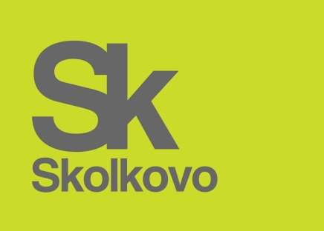
Competition and Intellectual Property Protection in the Pharmaceutical Sector
Alexey Ivanov Director, HSE-Skolkovo Institute for Law and Development Director, Legal Policy and Social Development Department, Skolkovo Foundation

Slide 2
The Slowing Down of Innovation In the Pharmaceutical Sector Is the World’s Common Concern
In the last 60 years, R&D efficiency has declined fairly steadily*
In 2014, fewer than half of new drugs approved by FDA came from traditional pharma groups**
In 2014, across all 12 major pharmaceutical companies, 58% of forecast revenues from innovation at the latest stage of development are sourced externally***
* J.W. Scannell et al., Diagnosing the Decline in Pharmaceutical R&D Efficiency, Nature Reviews Drug Discovery, vol. 11, 20120, pp. 191-200.
**A. Ward, Pharma: A Blueprint for Health?, Financial Times, 1 Jan. 2015.
*** Delloitte, Measuring the Return from Pharmaceutical Innovation 2014 Turning a Corner?

Slide 3
Where Biotech Technologies Come From?
The US biopharmaceutical industry’s growth was not, as is often claimed, rooted in business finance
The biotech industry in the US was ‘a direct product of the key role of the government in leading the development of the knowledge base that has thus provided firm success and the overall growth of the biotech industry*
*M. Mazzucato, The Entrepreneurial State: Debunking Public v. Private Sector Myths, Anthem, 2013.

Slide 4
The Role of Competition
The European Commission conducted a comprehensive inquiry of the pharmaceutical sector*:
A number of patent and licensing practices restrain innovation of the sector and are harmful for consumers
Patent regulation deform market competition even after patent term expiration
Competition Commission of India conducted its own inquiry in 2010:
Abuse of patent rights
US FTC:
“product hopping”
pay for delay
* EU Executive Summary of the Pharmaceutical Sector Inquiry Report. 2009.

Slide 5
The Most Restrictive Form of Regulation: Russia
Russian legislator chose to stick with the most restrictive form of regulation, which is extremely unusual especially for a developing country being primarily a recipient of technological innovation rather than its producer
Russian pharmaceutical market is now squeezed between Western multinationals and generic producers from China and India*
Prices for drugs in Russia are among the highest in the world**
* Pharma 2020
** The FAS three-year long sector inquiry, 2014

Slide 6
The Most Restrictive Form of Regulation: Russia
Complete exclusion from the any form of antitrust regulation (legal monopoly myth)*
In modern Russia, patent ships sail not an antitrust sea but the free and unrestricted waters of consumers’ pockets
Ban on compulsory licensing except in very few and unusually cases (provision never used)
Ban on parallel importation**
The customs authority is in charge of enforcing this restriction
No legislative provision of Bolar exemption
* Art. 10, 11 of the Federal Law on the Protection of Competition
** Para 6, Art. 1359 of the Civil Code

Slide 7
Losing a Unique Socialist Tradition
The Soviet Union was the only advanced industrial society based on principles – economic, social, philosophical – strikingly different from those of other industrial nations. That fact presents us… with rich analytical possibilities*
The system as a whole was operating on the basis of open exchange and scientific collaboration
Intellectual property did not exist as an instrument of commercialization but different forms of competition were widely used to incentivize inventions
Socialist competition was an elaborated process aimed at releasing human competitive forces based on a whole range of incentives – public recognition, career promotions and even material rewards (the first law appeared already in 1928)
*R. Loren, What Have We Learned about Science and Technology from the Russian Experience?, Stanford University Press, 1998, p. 134.

